Slide 1

Distributed Database Architecture
Week Three

Slide 2



Distributed Database Architecture
Key Components and Concepts
Examples
Homogenous Distributed Database Systems
Characteristics and Considerations
Heterogeneous Distributed Database Systems
Client/Server Database Architecture

Slide 3

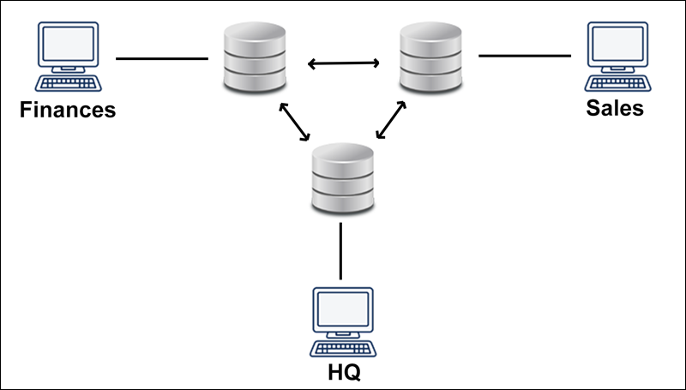
Distributed Database Architecture
Distributed database architecture is a model for organizing and managing a database system that spans multiple physical locations or nodes.
In this architecture, data is distributed across multiple computers or servers, and these nodes work together to provide a unified and coherent view of the database to users and applications.
The primary goal of distributed database architecture is to improve data availability, scalability, and fault tolerance, while also allowing for efficient data access and management.
It allows applications to access data from both local and remote databases.

Slide 4
Key Components and Concepts
Key components and concepts of distributed database architecture include:
Distributed Data: Data is divided into smaller parts or fragments and distributed across multiple nodes in the network. Each node may store a subset of the data, and the distribution can be done in various ways, such as partitioning, replication, or sharding.
Data Independence: Distributed databases typically provide a level of data independence, allowing applications to access data without needing to know the physical location or distribution of the data. This means that changes in the distribution of data can be transparent to the applications.
Transparency: Distributed database systems aim to provide transparency to users and applications, hiding the complexities of data distribution and management. Types of transparency include location transparency (users don't need to know where data is stored), replication transparency (users can access replicated data without knowing which copy is being used), and more.
Data Consistency: Ensuring data consistency across distributed nodes is a fundamental challenge in distributed database systems. Techniques such as distributed transactions and concurrency control mechanisms are used to maintain data integrity.
Query Processing and Optimization: Distributed database management systems (DDBMS) must be capable of processing queries that involve data from multiple nodes efficiently. Query optimization and distributed query processing algorithms are essential for achieving this goal.
Fault Tolerance: Distributed databases need to be resilient to failures of individual nodes or network partitions. Replication, redundancy, and backup strategies are employed to ensure data availability in the face of failures.

Slide 5
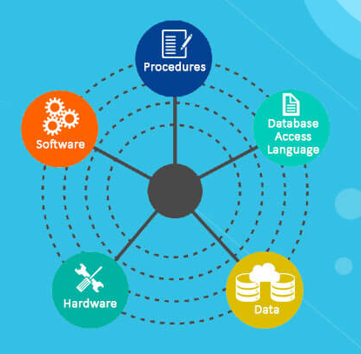
Key Components and Concepts
Scalability: Distributed database architectures can be scaled horizontally by adding more nodes to the network, which can help accommodate increasing data volumes and user loads.
Security and Access Control: Distributed database systems must implement robust security measures to protect data across distributed nodes. Access control mechanisms are used to restrict access to authorized users.
Data Distribution Strategies: Different strategies can be employed for data distribution, including data partitioning (dividing data based on a specific attribute), data replication (copying data to multiple nodes), and data sharding (dividing data into smaller subsets called shards).

Slide 6

Examples
Examples of Distributed Database Systems include
Google Spanner
Amazon DynamoDB
Various NoSQL databases that support distributed deployments
These systems are designed to meet the demands of modern, highly distributed and scalable applications that operate across a network of interconnected nodes.

Slide 7
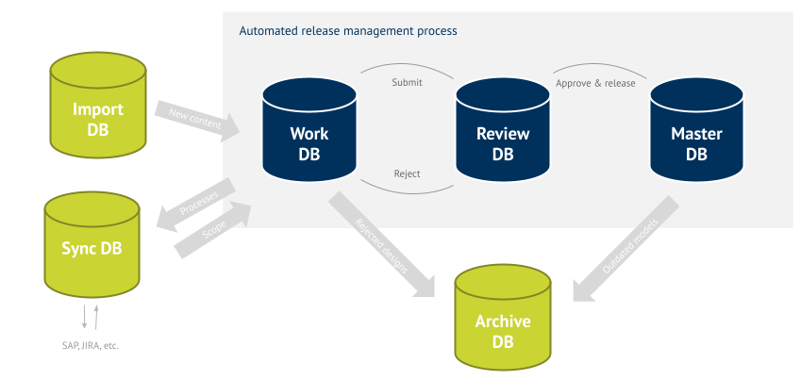
Distributed Database Architecture
It allows applications to access data from both local and remote databases.
The common Architectures are :
Homogenous Distributed Database Systems
Heterogeneous Distributed Database Systems
Client/Server Database Architecture

Slide 8
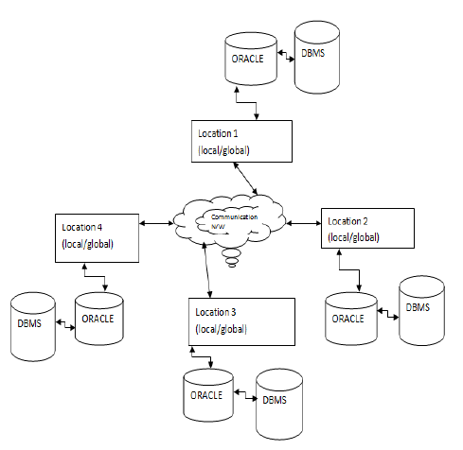
Homogenous Distributed Database Systems
Homogeneous distributed database systems refer to a type of distributed database architecture where all nodes in the network use the same database management system (DBMS) software and have uniform hardware and software configurations.
In a homogeneous distributed database system, data is still distributed across multiple nodes, but the consistency and compatibility of the DBMS software and hardware configurations are maintained across all nodes.
It is a network of two or more Oracle Databases that reside on one or more machines.
An application can simultaneously access or modify the data in several databases in a single distributed environment.
The sites use similar software.
The sites use identical DBMS or DBMS from the same vendor.
Each site is aware of all other sites and cooperates with other sites to process user requests.
The database is accessed through a single interface as if it is a single database.

Slide 9
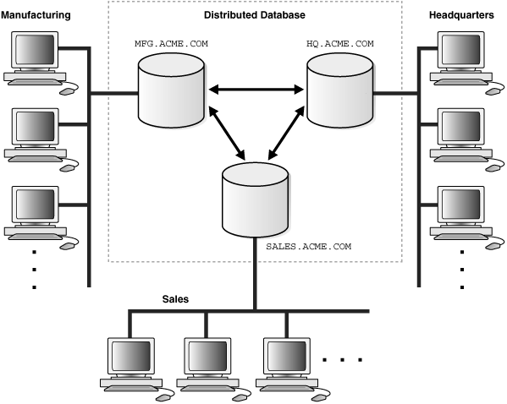
Homogenous Distributed Database Systems
This illustration shows a homogeneous distributed database.
The figure shows three databases, HQ.ACME.COM, SALES.ACME.COM, and MFG.ACME.COM.
Each database is connected to a number of client systems at Headquarters and the Sales and Manufacturing divisions, respectively.

Slide 10
Characteristics and Considerations
Key characteristics and considerations of homogeneous distributed database systems include:
Uniformity: All nodes in the system run the same type of DBMS software from the same vendor and typically have the same configuration in terms of hardware, operating system, and network protocols. This uniformity simplifies system management and administration.
Data Consistency: Ensuring data consistency is typically more straightforward in homogeneous systems because all nodes use the same DBMS software, which implements consistent data storage and access rules and protocols.
Transaction Management: Homogeneous systems often use a centralized approach to transaction management, making it easier to maintain data consistency and integrity across the entire distributed database.
Query Processing: Query processing in a homogeneous distributed database is often more efficient because the same query optimization and execution strategies can be applied uniformly across all nodes.
Ease of Maintenance: The uniformity of hardware and software configurations simplifies system maintenance, updates, and troubleshooting, as administrators do not need to manage a diverse set of technologies.
Compatibility: Applications that access the database can be developed more easily because they interact with a consistent DBMS interface, regardless of the physical location of the data.
Scalability: Homogeneous systems can still be scaled horizontally by adding more nodes that adhere to the same configuration and DBMS software. This allows for increased capacity as the database workload grows.
Vendor Lock-In: One potential drawback of homogeneous distributed database systems is vendor lock-in. Since all nodes use the same DBMS software from a single vendor, it can be challenging to switch to a different DBMS vendor without significant migration efforts.
Performance: Homogeneous systems can achieve good performance in scenarios where the workload and data distribution are well-suited to the capabilities of the chosen DBMS software.

Slide 11
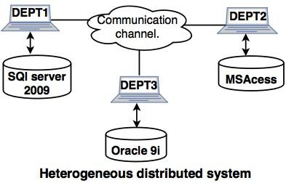
Heterogeneous Distributed Database Systems
Heterogeneous distributed database systems refer to a type of distributed database architecture where different nodes in the network use different database management systems (DBMS) or have varying hardware and software configurations.
In a heterogeneous distributed database system, data is still distributed across multiple nodes, but the nodes may run different DBMS software, have diverse hardware platforms, or use different operating systems.
In this System at least one of the databases is a Non-Oracle Database System.
Different sites use dissimilar schemas and software.
Query processing is complex due to dissimilar schemas.
Transaction processing is complex due to dissimilar software.
A site may not be aware of other sites and so there is limited co-operation in processing user requests.

Slide 12
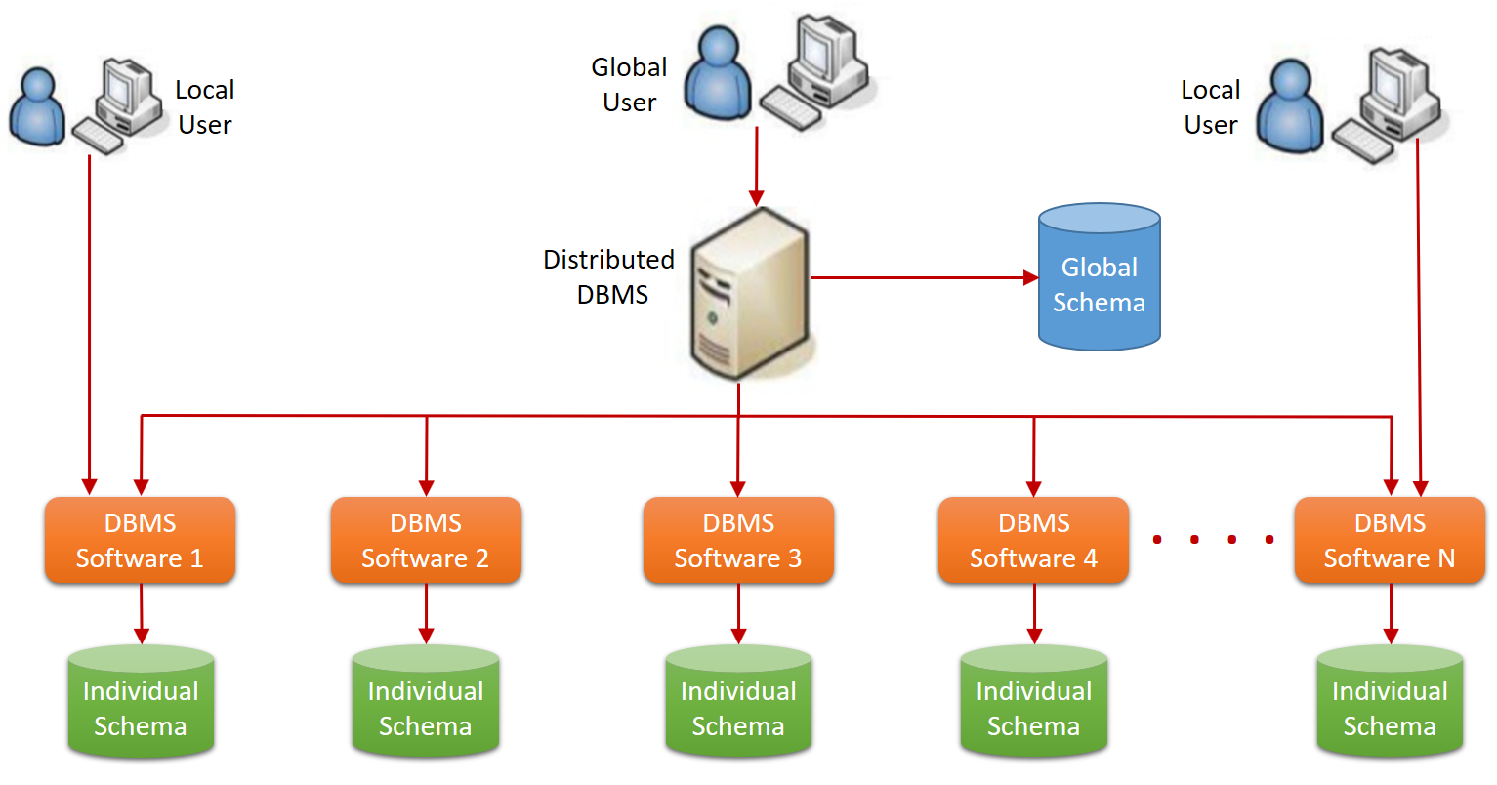
Heterogeneous Distributed Database Systems
The following are some of the characteristics of the heterogeneous distributed database environment:
Information is distributed between all the individual database management system's nodes
A versatile database management system can be installed across individual database systems
Local users, ...

Slide 13
Characteristics and Considerations
Key characteristics and considerations of heterogeneous distributed database systems include:
Diversity: Heterogeneous systems embrace diversity in terms of DBMS software, hardware configurations, and operating systems. Different nodes may use different DBMSs from various vendors, which can provide flexibility but also complexity.
Data Integration: Data integration is a significant challenge in heterogeneous systems because data from different sources may have varying structures, formats, and semantics. Middleware and data transformation layers are often used to facilitate data integration.
Data Consistency: Achieving data consistency can be more complex in heterogeneous systems because different DBMSs may have varying transaction management and concurrency control mechanisms. Ensuring that data remains consistent across diverse systems requires careful planning and coordination.
Query Processing: Query processing in a heterogeneous environment may require translating queries from one DBMS's query language to another, which can introduce additional complexity and performance overhead.
Transaction Management: Coordinating distributed transactions across heterogeneous DBMSs may involve the use of distributed transaction managers and two-phase commit protocols to ensure data consistency.
Flexibility: Heterogeneous systems offer flexibility in choosing the most suitable DBMS or hardware configuration for specific tasks or nodes within the network.
Vendor Neutrality: Unlike homogeneous systems, heterogeneous systems are not tied to a single DBMS vendor. This can make it easier to adapt to changing requirements or migrate to different DBMSs when necessary.
Performance Considerations: Performance in heterogeneous systems can vary depending on the capabilities of each DBMS and the efficiency of data integration processes. Optimizing performance may require careful tuning and optimization efforts.
Scalability: Heterogeneous systems can still be scaled horizontally by adding nodes with different configurations, but managing the diversity becomes a key challenge.

Slide 14
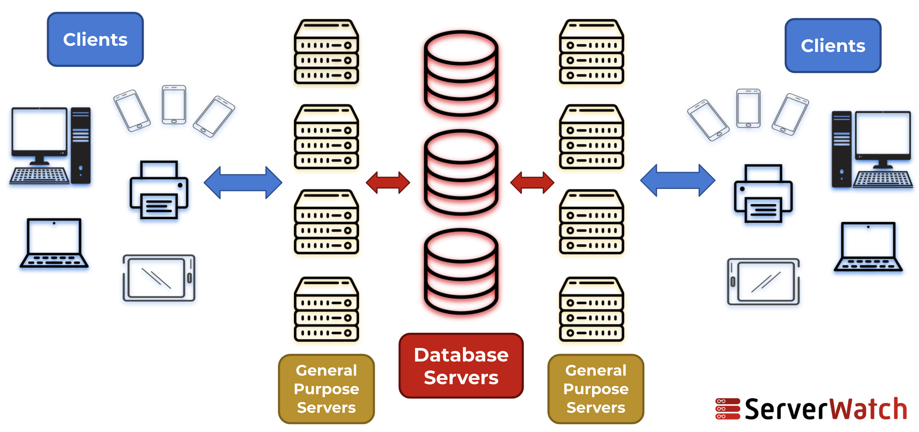
Client/Server Database Architecture
A database server is the Oracle software managing a database, and a client is an application that requests information from a server.
Each computer in a network is a node that can host one or more databases. Each node in a distributed database system can act as a client, a server, or both, depending on the situation.
This is a two-level architecture where the functionality is divided into servers and clients.
A client can connect directly or indirectly to a database server.
A direct connection occurs when a client connects to a server and accesses information from a database contained on that server.
SELECT * FROM dept;
An indirect connection occurs when a client connects to a server and then accesses information contained in a database on a different server. (if connected to hq database, but access emp table on remote sales database)
SELECT * FROM emp@sales;

Slide 15
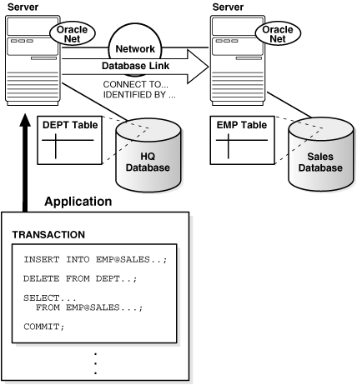
Client/Server Database Architecture
This illustration depicts an Oracle distributed database system.
There are two databases located on separate servers: HQ and SALES.
The figure shows examples of direct and indirect client connections. Queries are made to the HQ database directly, and queries are made indirectly to the SALES database, through the HQ database, which then acts as a client.
Communication between the servers occurs over the network using Oracle Net.

Slide 16

Advantages and Disadvantages
Advantages Of Client Server Architecture
The data is centralized within the system that is maintained in a single place.
The model is efficient in delivering resources to the client and also requires low-cost maintenance.
It is easy to manage, and the data can be easily delivered to the client.
As the data is centralized, this system is more secure and serves added security to the data.
Within this type of model, more clients and servers can be embedded into the server, which makes the performance outstanding and increases the model’s overall flexibility.
Disadvantages Of Client Server Architecture
Clients’ systems can get a virus or any malicious scripts if any are running on the server.
Extra security must be added so that the data does not get spoofed in between the transmission.
The main problem can be server down. When the server is down, the client loses its connection and will not access the data.

Slide 17

References
https://docs.oracle.com
https://www.tutorialspoint.com

